Slide 1
LECTURE # 06 SECTIONS AND ELEVATIONS

Slide 2
ELEVATION
An orthographic view of some vertical feature of a house. (Front, rear, side, interior elevation)
Basic Elevations include the following elements only: Walls, windows & doors. Molding, baseboards, paneling, window & door trim etc. skeletal representation, outline only Detail within trim, moulding, paneling, etc. not shown. Heights annotated.
Elevations are drawn on a single plane, showing no depth. They supply information that cannot be given on the plan view of an object.

Slide 3
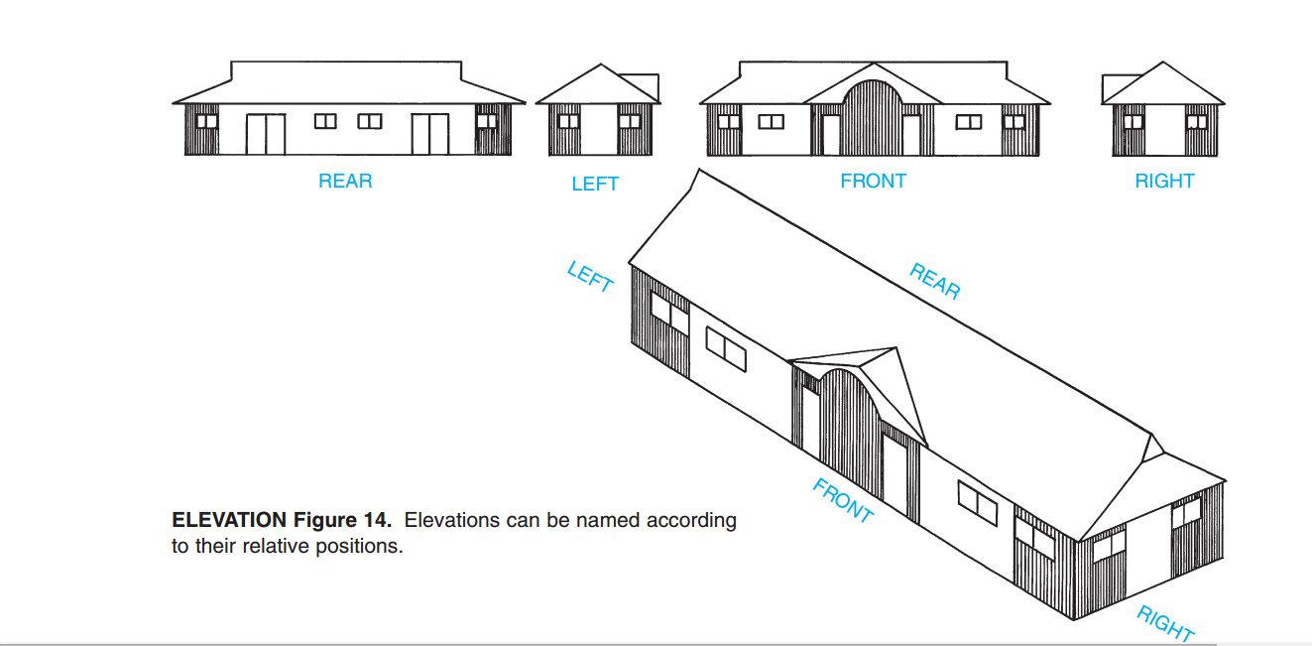

Slide 4
SECTION
A representation of a portion of a building or object exposed when cut by an imaginary vertical plane so as to show its construction and interior.
It is a cut from the foundation through roof. Includes walls, windows, doors, floors, ceilings, and observable major structural elements only. Does not include interior ornamentation & trim.

Slide 5
DIFFERENCES IN CONCEPT OF DRAWING PLANS, SECTIONS AND ELEVATIONS
Plans are drawn, elevations are dropped and sections are cut.
An elevation is looking at the side of something. You can show everything you would see from front to back and can include hidden lines for things behind. A section however is what you would see if you cut an object. You would only show what you can see at the cut line nothing in front and nothing behind.
The difference between Elevations and Sections is that Elevations start at the finished floor elevation and stop at the ceiling. Elevations show individual walls in specific rooms, whereas Sections cut through floors showing multiple rooms stacked on top of each other.

Slide 6
DIFFERENCES IN CONCEPT OF DRAWING PLANS, SECTIONS AND ELEVATIONS
Think of plans, elevations and sections by picturing three apples; one sliced vertically, one horizontally and one without cutting. Those seeds really tell a story.
ELEVATION
PLAN
SECTION

Slide 7
USE OF SECTION DRAWINGS
Architects use Sections for a number of reasons. They deduce structural information to determine the strength of the building via floor thickness and floor span relative to load bearing walls. Sections also show any observable framing, such as is available in the foundation or the roof framing system. Architects need to know this information prior to designing structural changes to the building.

Slide 8
USE OF ELEVATION DRAWINGS
Elevations are scaled drawings showing what the building should look like when construction is completed. An elevation is the view of the structure that the worker has from a normal standing position.
Elevation drawings tell locations of windows and doors, types of wall finishes to be used, exterior trim, location of exterior cooling and heating equipment, and other vital information.

Slide 9
IMPORTANT POINTS TO CONSIDER
Cutting objects have dark tone.
Ground line, where object lies, has the darkest tone.
Dotted box in plan shows that object has difference of height.
Lines at 45 degree shows that object is internally filled.
If shading of objects is opposite, it shows they have different materials.
Level of cutting a section varies from project to project. Like cutting from 1’ we will get specifications of walls only. If height varies, we may get section of window.
Sill level: Start of height of window (inside).

Slide 10
FLOOR SPECIFICATIONS
Compact Earth.
Sand Fillings:
A fine mixture of sand is filled over the compact earth to make it at higher level from lawn level about 2-3 feet. Except sand fillings total height becomes 7” (1”+2”+4”) so for 2’ height, we will fill 17” sand fillings (24”-7”=17”)
Hard core (4”)
It is also known as Brick ballast (broken bricks). It increases bearing capacity of the earth. Lean concrete cement (viscous mortar) is added in hardcore to make the material bonded, compact and unified.
Plane Concrete Cement: PCC (1.5” -2”)
Concrete = cement: Sand: Crush (1:2:4).
Addition of PCC is to make the level of surface smooth. PCC means PCC having different levels (slope) on ground.
Finishing Material (1”)
Tiles or marble

Slide 11
INTERMEDIATE ROOF SPECIFICATIONS
RCC slab (4.5”-6”)
Hard core (not mixed with lean cement) (4”)
PCC (Screeding) (1.5” -2”)
Finishing material (1”)

Slide 12
ROOF SPECIFICATIONS
RCC slab (4.5”-6”)
Reinforced Concrete Cement (RCC = PCC + Steel)
2 layers of bitumen (10/40)
It is an engineering material having specific standard. 10/40 means that it can penetrate minimum 10 millimeters to 40 millimeters. It is a canvas like cloth soaked in concrete. It is used in form of layers.
0.5“ Layer of polythene
Never apply on hot bitumen instantly otherwise they will stick together as both are organic materials. Apply sand spray to make hot bitumen and the sheet inert.
Insulating material
Thermopore sheet ( 2”) or
Jumborine (1”)

Slide 13
ROOF SPECIFICATIONS
Roofing tiles. 1.5”
In the formation of tiles, there are two patterns.
Laying of tiles: having no difference/space while laying the tiles, it tends to the absence of binding material between the tiles. So ultimately after some times cracks are observed.
Grouting method: in this method minimum of ¼” spaces are given between two tiles.

